Slide 1
Introduction To Se & Se Modeling
SE-412
Muhammad Faisal Akram
MS(CS) Software Engineering
0322-7015352

Slide 2
Introduction
Software Engineering:
Process of analyzing user requirements and then designing, building, and testing software application which will satisfy those requirements.
Detailed study of engineering to the design, development and maintenance of software.
SDLC – Software development life cycle is the process to develop a software.

Slide 3
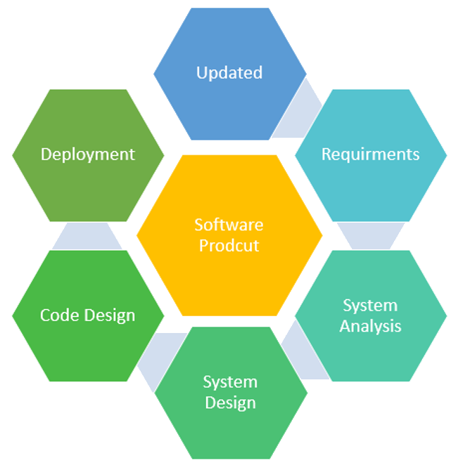
SDLC Process

Slide 4
SDLC Models
Water fall model
V-model
Incremental model
Spiral Model
RUP
Scrum
XP
AGILE

Slide 5
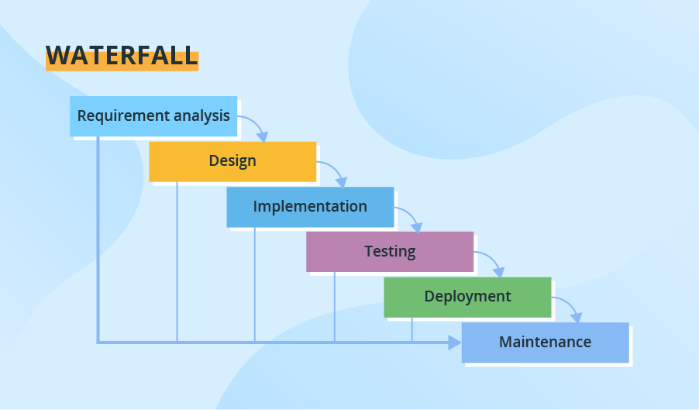
Waterfall Model

Slide 6
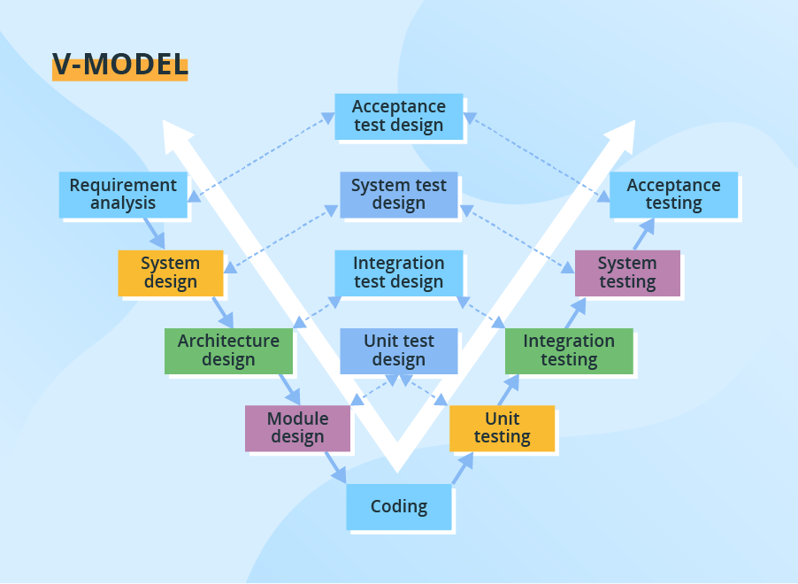
V-Model

Slide 7
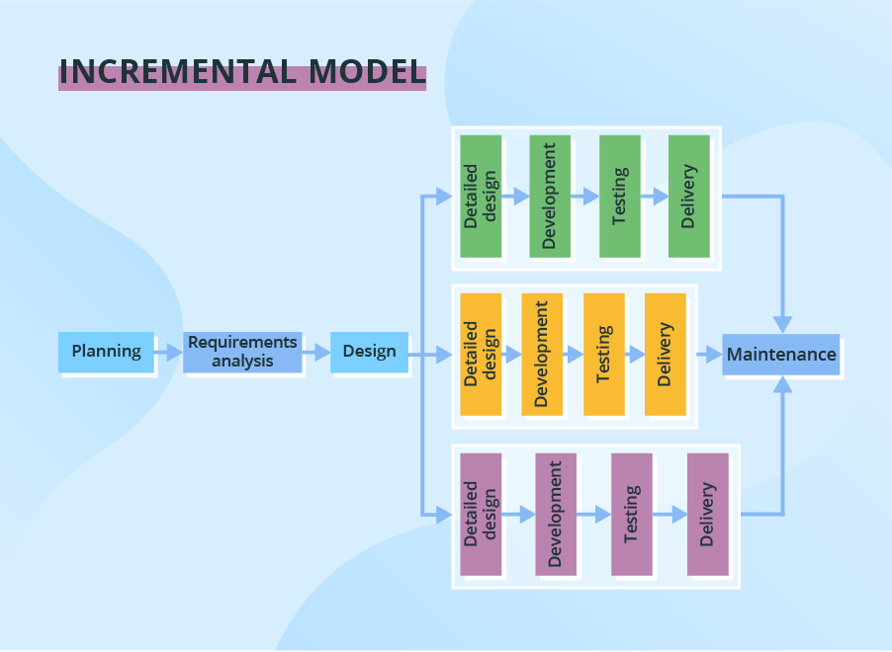
Incremental Model
Notes:
1- In each iteration new software modules are added.
2- Development process will proceed either sequentially or in parallel.

Slide 8
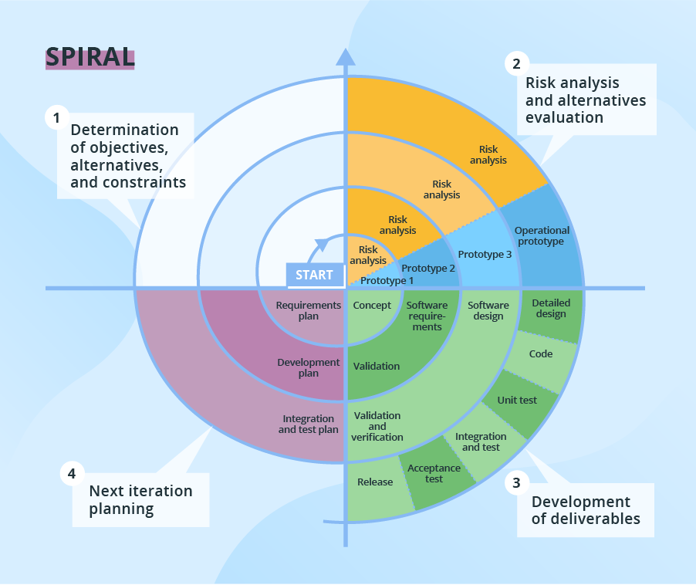
Spiral Model
Notes:
1- It focuses on Risk assessment.
2- Spiral iteration will lasts around 6 months with 4 important activities:
a- Planning, b- Risk Analysis, c- Prototypes Creation, d- Evaluation of previously delivered part
3- Intensive customer involvement but not acceptable during development.

Slide 9
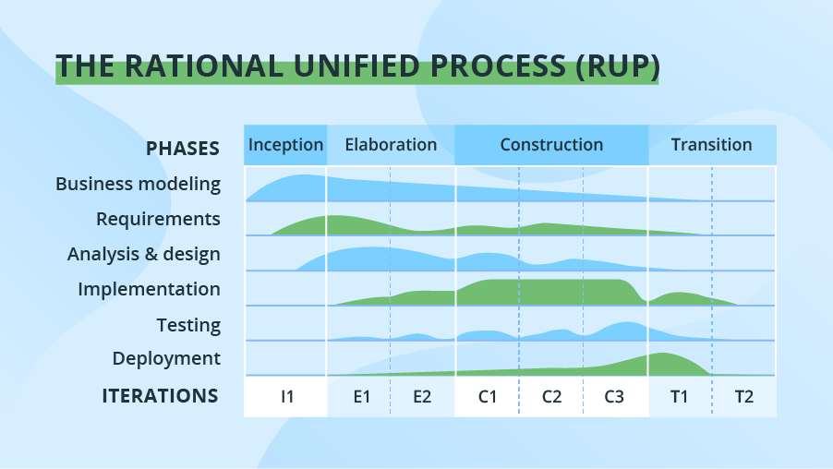
Rational Unified Process
Notes:
1- Combination of Linear & Iterative frameworks

Slide 10
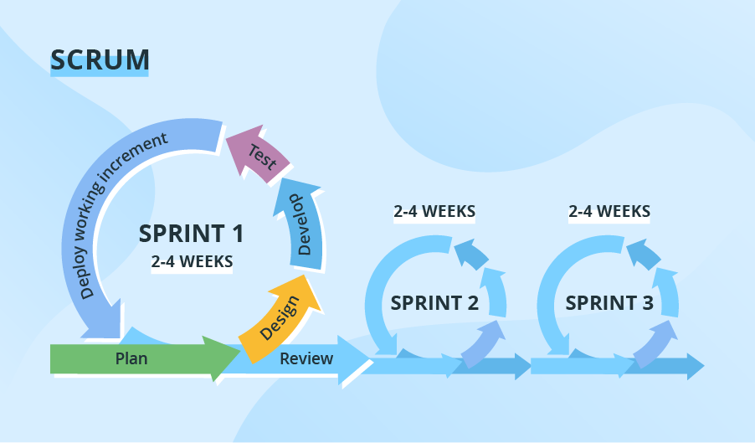
Scrum (Agile)
Notes:
1- Most popular Agile model

Slide 11
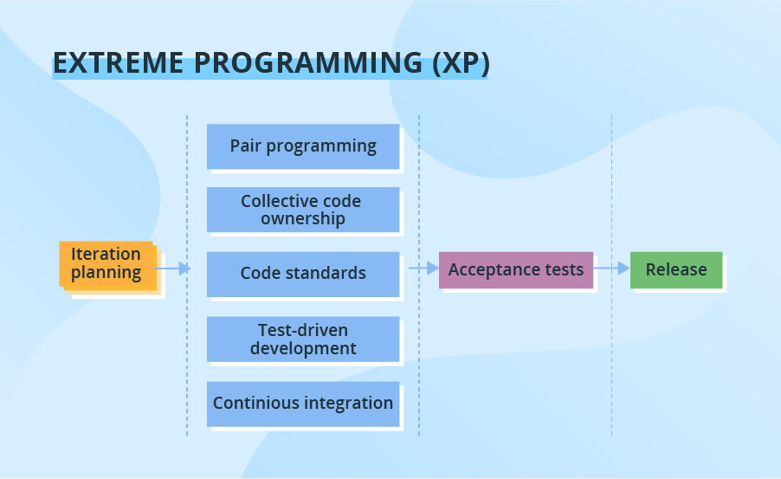
XP – Extreme Programming (Agile)

Slide 12
Analysis and Design
Analysis:
It emphasizes an investigation of the problem and requirements, rather than a solution.
Requirements analysis
An investigation of the requirements
Object analysis
An investigation of the domain objects.
Design:
It emphasizes a conceptual solution that fulfills the requirements, rather than its implementation.
do the right thing (analysis), and do the thing right (design).

Slide 13
OO Analysis
OO Analysis emphasizes on finding and describing the objects in the system or concepts in the problem domain.
Example
Considering the example of Student information system, the concepts are students, teachers, class, courses etc.

Slide 14
OO Design
OOD emphasizes on defining software objects and how they collaborate to fulfill the requirements.
Example:
In the library system, a Book software object may have a title attribute and a getChapter method.
During implementation or object-oriented programming, design objects are implemented, such as a Book class in Java.

Slide 15
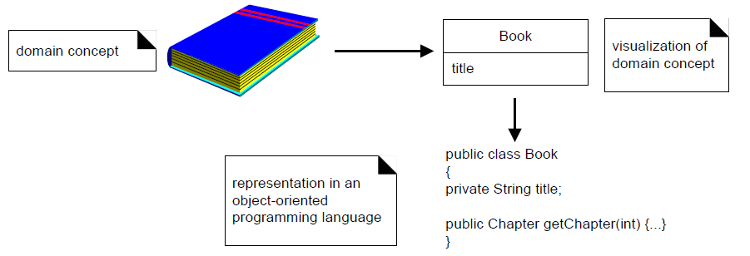
OO Design

Slide 16
Explanation with Example
Use Case
Lets take an example of a dice game in which a player rolls two die.
At first stage we can describe use cases.
Use cases are simply the written stories about the required process.

Slide 17
Explanation with Example
Domain Model
A decomposition of the domain involves an identification of the concepts, attributes, and associations.
The result can be expressed in a domain model, which is illustrated in a set of diagrams that show domain concepts or objects.

Slide 18
Explanation with Example
Domain Model

Slide 19
Explanation with Example
Define Interaction diagrams
Interaction diagrams shows the collaboration of software objects
Interaction diagrams illustrates the essential steps involved by sending messages to desired class.
It also shows the flow of messages between different objects.

Slide 20
Explanation with Example
Define Interaction diagrams

Slide 21
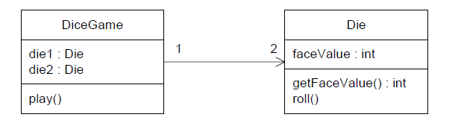
Explanation with Example
Design Class Diagram
Design Class Diagram is useful for creating static view of the class definitions.
This illustrates the attributes and methods of the classes.
For example, in the dice game, an inspection of the interaction diagram leads to the partial design class diagram shown in Figure below.

Slide 22
Iterative Development & The Unified Process

Slide 23
Iterative Development
Introduction
Iterative development is a skillful approach to software development, and lies at the heart of the OOA/D.
A software development process describes an approach to building, deploying, and possibly maintaining software.

Slide 24
Benefits of Iterative Development
Early rather than late mitigation of high risks (technical, requirements, objectives, usability, and so forth).
Early visible progress.
Early feedback, user engagement, and adaptation, leading to a refined system that more closely meets the real needs of the stakeholders.
Managed complexity; the team is not overwhelmed by "analysis paralysis" or very long and complex steps.
The learning within an iteration can be used to improve the development process itself, iteration by iteration

Slide 25
Iteration length & Time-boxing
The UP (and experienced iterative developers) recommends an iteration length between two and six weeks.
Small steps, rapid feedback, and adaptation are central ideas in iterative development; long iterations subvert the core motivation for iterative development and increase project risk.
Much less than two weeks, and it is difficult to complete sufficient work to get meaningful throughput and feedback; much more than six or eight weeks, and the complexity becomes rather overwhelming, and feedback is delayed.
A very long iteration misses the point of iterative development. Short is good.

Slide 26
Iteration length & Time-boxing
A key idea is that iterations are time-boxed, or fixed in length. For example, if the next iteration is chosen to be four weeks long, then the partial system should be integrated, tested, and stabilized by the scheduled date.
If it seems that it will be difficult to meet the deadline, the recommended response is to remove tasks or requirements from the iteration, and include them in a future iteration, rather than slip the completion date.

Slide 27
Unified Process
The Unified Process has emerged as a popular and effective software development process for building object-oriented systems.
In particular, the Rational Unified Process (RUP), as modified at Rational Software, is widely practiced and adopted by industry.
The critical idea in the Rational Unified Process is Iterative Development.
Iterative Development is successively enlarging and refining a system through multiple iterations, using feedback and adaptation.

Slide 28
Rational Unified Process
RUP is a complete software-development process framework , developed by Rational Corporation.
It’s an iterative development methodology based upon six industry-proven best practices.
Processes derived from RUP vary from lightweight—addressing the needs of small projects —to more comprehensive processes addressing the needs of large, possibly distributed project teams.

Slide 29
Phases in Rational Unified Process
RUP is divided into four phases, named:
Inception
Elaboration
Construction
Transition

Slide 30
Phases in Rational Unified Process
Each phase has iterations, each having the purpose of producing a demonstrable piece of software.
The duration of iteration may vary from two weeks or less up to six months.
Iterations
Iterations
Iterations
Iterations
Inception
Elaboration
Construction
Transition

Slide 31
Inception
The life-cycle objectives of the project are stated, so that the needs of every stakeholder are considered.
Scope and boundary conditions, acceptance criteria and some requirements are established.
There are some activities of Inception phase as follows:
Formulate the scope of the project.
Needs of every stakeholder, scope, boundary conditions and acceptance criteria established.
Plan and prepare the business case.
Define risk mitigation strategy, develop an initial project plan and identify known cost, schedule, and profitability trade-offs.
Synthesize candidate architecture.
Candidate architecture is picked from various potential architectures
Prepare the project environment.

Slide 32
Inception – exit criteria
An initial business case containing at least a clear formulation of the product vision - the core requirements - in terms of functionality, scope, performance, capacity, technology base.
Success criteria (example: revenue projection).
An initial risk assessment.
An estimate of the resources required to complete the elaboration phase.

Slide 33
Elaboration
An analysis is done to determine the risks, stability of vision of what the product is to become.
Stability of architecture and expenditure of resources.
Identification of most requirements and scope and realistic estimates.
Entry Criteria
The products and artifacts described in the exit criteria of the previous phase.
The plan approved by the project management, and funding authority, and the resources required for the elaboration phase have been allocated.

Slide 34
ASSIGNMENT

Slide 35
QUIZ

